Slide 1
Communication Skills as Career Filters
Week 1, Unit 1
CC11 Communication in the Workplace
Bretz Harllynne M. Moltio

Slide 2
Table of Contents
Communication skills as the ticket to success
Concepts in communication
Introduction to human behavior in organization

Slide 3
Communication Skills as the Ticket to Success
Communication skills are soft skills | Importance of communication skills | Related communication skills

Slide 4
Communication Skills are Soft Skills
Soft Skills
Abilities that relate to how one works and interacts with other people
Hard skills – technical knowledge or training gained throughout one’s career and education
Examples:
Teamwork
Interpersonal skills
Creativity
Adaptability

Slide 5
Communication Skills are Soft Skills
Why Soft Skills?
Typically difficult to teach
Better taught when younger
Can be used for every single situation (career, friends and family, groups, community)
Higher employability
It’s possible to beat someone who has better / same hard skills
Those with better soft skills usually stay longer in the company

Slide 6
Communication Skills are Soft Skills
Common Top Soft Skills:
Communication
Problem solving
Creativity (resourcefulness)
Adaptability (can work under pressure)
Work ethic (punctuality, dealing with others)

Slide 7
Importance of Communication Skills
A means for team building
Everyone can give their own opinion
Innovation
Personal and professional growth
Strong management

Slide 8
Related Communication Skills
Active learning
Confidence
Conflict resolution
Negotiation
Public speaking
Writing
Nonverbal communication
Empathy

Slide 9
Concepts in Communication
Communication and communication skills | The communication process | Types of communication | Areas of communication

Slide 10
Communication and Communication Skills
Communication
Transfer of information or message from one entity to another
Have at least one sender, and at least one receiver
Communication Skills
Set of abilities to transfer information between different entities in different situations

Slide 11
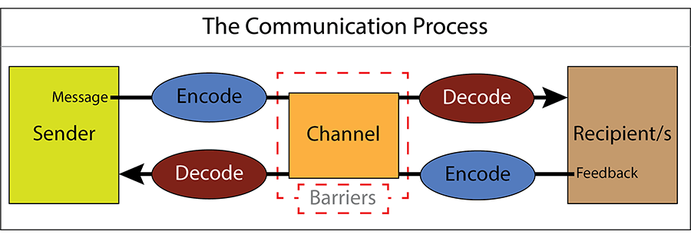
The Communication Process

Slide 12
Types of Communication
Verbal
Medium of the message is oral
Examples:
Face-to-face
Telephone
Radio
Television
Messenger call

Slide 13
Types of Communication
Non-Verbal
Part of verbal communication
Examples:
Facial expressions
Body stance
Tone of voice
Volume of speech

Slide 14
Types of Communication
Written
Medium of the message is printed or digital
Examples:
Memorandums
Proposals
E-mails
Letters
Training manuals
Operating policies

Slide 15
Areas of Communication
Focuses on how communication is implemented
Verbal
Speaking
Listening
Written
Reading
Writing

Slide 16
Introduction to Human Behavior in Organization
Organizational behavior | Importance of HBO in communication

Slide 17
Organizational Behavior
Study of human behavior in:
Organizational settings
Interface between human behavior and the organization
Organization itself

Slide 18
Why HBO on Communication?
Communication style varies on the company and team (“Company culture”)
Tasks in HBO require strong communication skills for the leader and team members

Slide 19
Company Culture
Also known as organizational culture
Defines the proper way to behave within the organization
Includes shared beliefs and values
Sets the context for everything an organization does
Every company has a different type of culture
Effects:
Strong culture = higher success rate for companies
Weak culture = brings down the organization and its leadership
Merging companies can be broken down with conflicting cultures

Slide 20
Tasks in Organizational Behavior
Job satisfaction
Finding the right people
Organizational culture
Leadership and conflict resolution
Understanding employees better
Understand how to develop good leaders
Develop a good team
Higher productivity

Slide 21
References
https://www.indeed.com/career-advice/resumes-cover-letters/soft-skills
skillsyouneed.com/ips/what-is-communication.html
https://www.iedunote.com/organizational-behavior
https://www.shrm.org/resourcesandtools/tools-and-samples/toolkits/pages/understandinganddevelopingorganizationalculture.aspx

